Slide 1
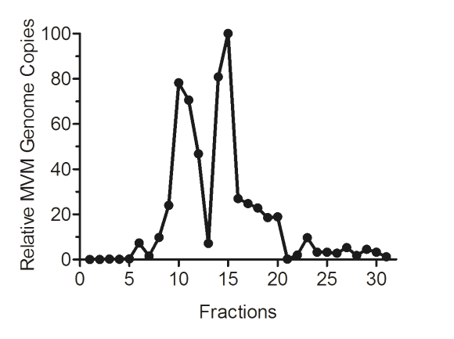
Fig. 1
A
B
C
D
P1
P2
7
8
9
10
11
12
13
14
15
16
17
18
19
20

Slide 2
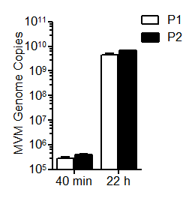
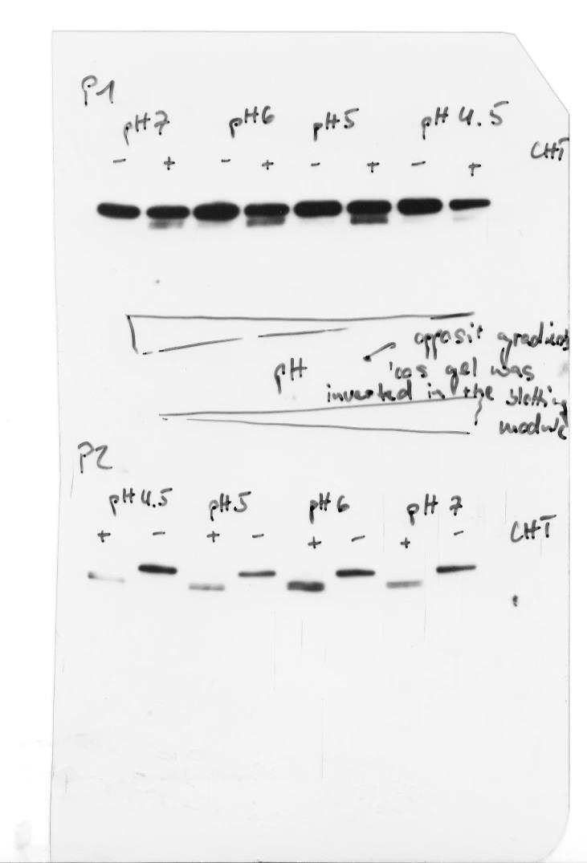
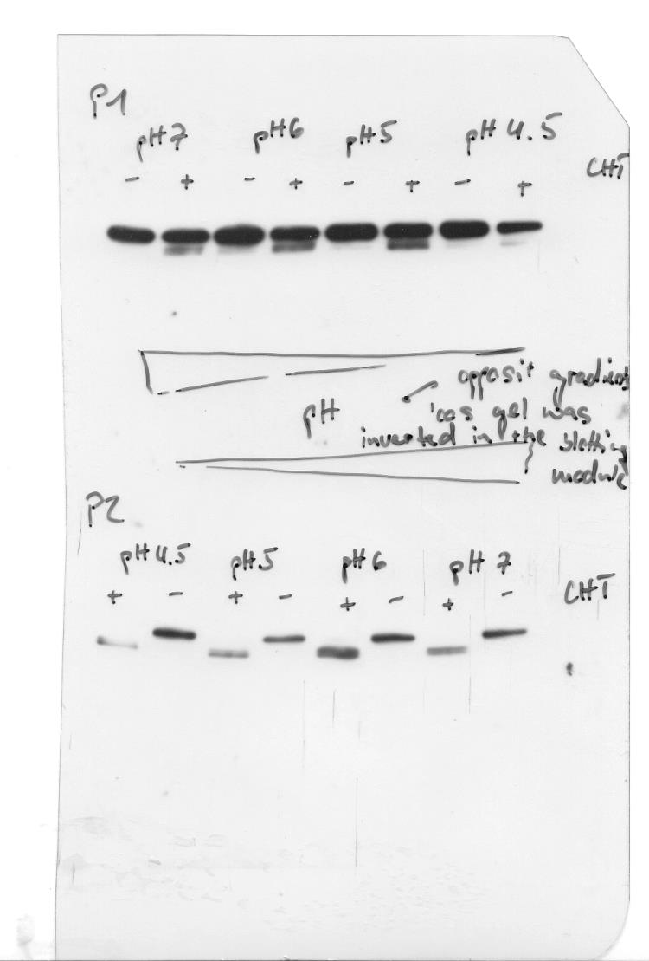
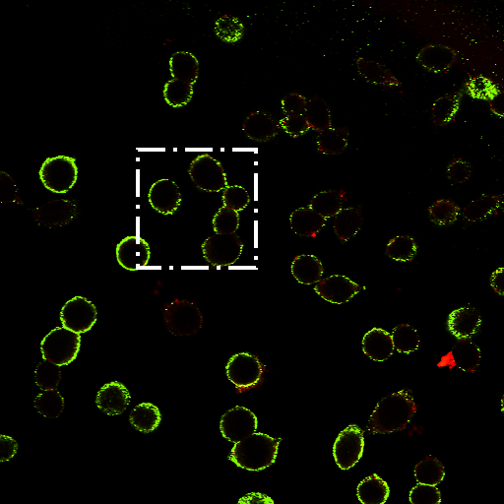
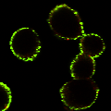
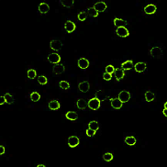
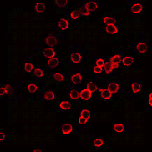
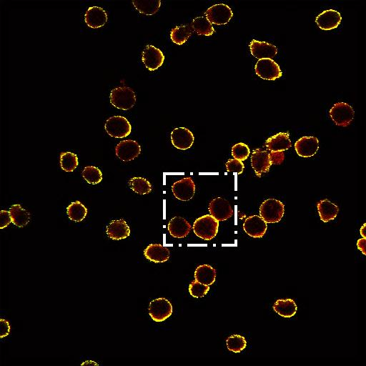
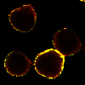
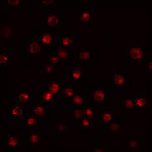
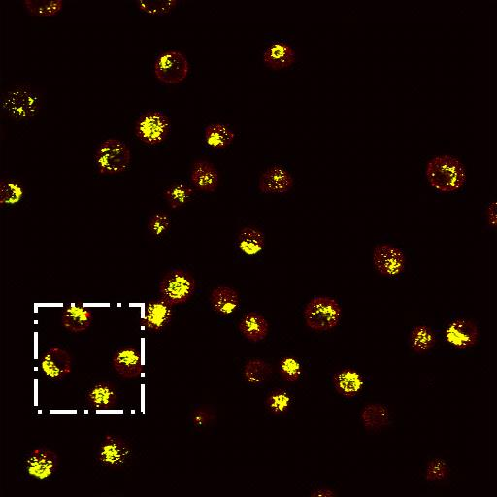
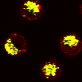
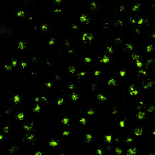
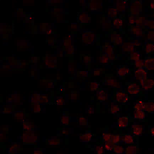
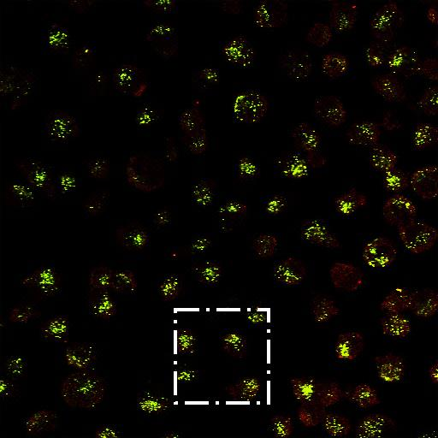
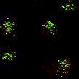
Fig. 2
A
B
C
D
E
pH 7
pH 6
pH 5
-
+
-
+
-
+
CHT
P1
VP2
VP3
P2
VP2
VP3
F
G
α Capsid
α N-VP2
Merge
Detailed
P1
Binding
P2
P1
4h Internalization
P2

Slide 3
Fig. 3
A
B
C
D

Slide 4
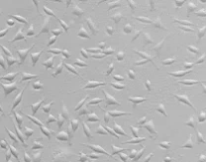
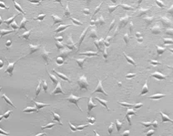
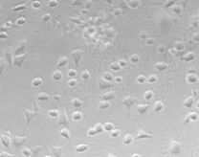
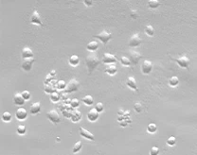
Fig. 4
A
B
C
D
10 h
20 h
30 h
99 %
100 %
40 h
98 %
58 %

Slide 5
Fig. 5
A
B
WANTED
Virions (IP)
Hpt
(0, 12, 24, 36, 48)

Slide 6
Fig. 6
A
B

Slide 8
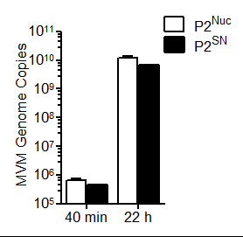
Fig. 7
IF
WB
P2(NUC) / P2(SN) Stability

Slide 9
Fig. 8
A
Progeny virions
B
Incoming virions
A9
NB324K
A9
10 h
10 h
5 min
14 h
14 h
6 h
18 h
18 h
6 h + BafA₁

